Slide 1
Dashboard

Slide 2
What is Dashboard?
A Power BI dashboard is a single page, often called a canvas.
Dashboards tells a story through visualizations.
Because it's limited to one page, a well-designed dashboard contains only the highlights of that story.
Readers can view related reports for the details.
Dashboards are a feature of the Power BI service only.
Dashboards cannot be created in Power BI Desktop and also cannot be viewed in Power BI Desktop

Slide 3
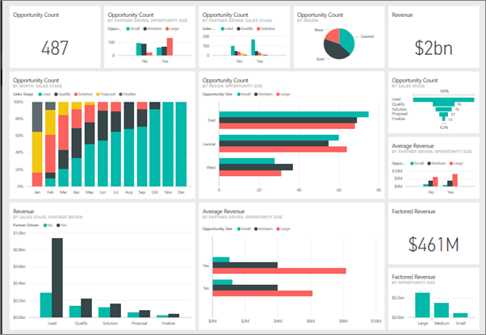
Example of a Dashboard

Slide 4
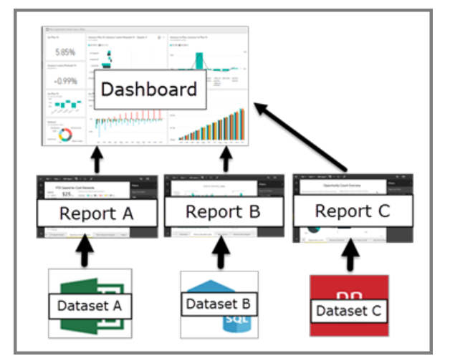
Dashboard Formation

Slide 5
Dashboard Formation

Slide 6
Dashboard Formation

Slide 7
Advantages of Dashboards
Dashboards are a wonderful way to monitor your business and see all of your most important metrics at a glance.
The visualizations on a dashboard can come from one underlying dataset or many, and from one underlying report or many.
A dashboard combines on-premises and cloud data, providing a consolidated view regardless of where the data lives.
A dashboard isn't just a pretty picture. It's highly interactive and the tiles update as the underlying data changes.

Slide 8
Dashboards Vs. Reports

Slide 9
